Slide 1
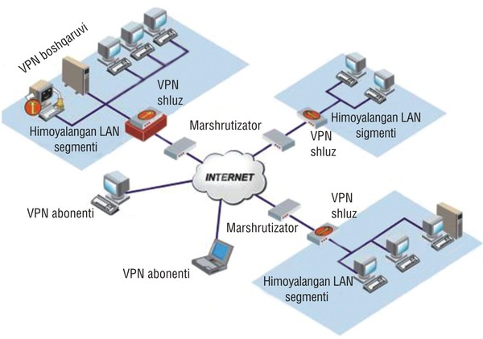
TARMOQ ADMINISTRATORLIGI 21-DARS

Slide 2
nano /etc/ssh/sshd_config (faqat ruhsat etilgan user nomi kiraoladi masofan linuxga)
AllowUsers muhammadjon (user_nomi)
AllowGroups (ruhsat etilgan guruh nomi)
DenyUsers (ruhsat etilmagan user nomi)
DenyGroups (ruhsat etilmagan guruh nomi)
date -s "2019-11-20 19:53:00“ (Linux os ni vaqtini o’zgartirish)
azimov ALL=ALL,!/bin/bash,!/bin/su,/bin/su - iqusr,!/usr/sbin/useradd,!/usr/sbin/userdel,!/usr/bin/passwd root,!/usr/sbin/visudo

Slide 3
Linux operatsion tizimida Scriptlar yaratish
Misol:Script yaratishga
1. nano script.sh
#! /bin/bash
reboot
2. chmod +x script.sh or (chmod 777 script.sh)
3. nano script.sh
#!/bin/bash
mkdir scripts
cd scripts
touch f1 f2 f3
ls -al

Slide 4
Linux operatsion tizimida Scriptlar yaratish
Misol:Script yaratishga
nano script.sh
2. #! /bin/bash
reboot
3. Date
4. nano /etc/crontab
5. 01 7 * * * root /script.sh

Slide 5
Linux operatsion tizimida Planlar yaratish
1. Har dushanba kuni soat 9:00 va 18:00 da skriptni ishga tushirish
0 9,18 * * 1 /script.sh
2. Har kuni 0:30 va 12:30 da skriptni ishga tushirish:
30 */12 * * * script.sh
3. Har oy 1-da soat 12:00 da ishga tushiring:
0 12 1 * * script.sh
4.Dushanba va juma kunlari yarim tunda ishlating:
0 0 * * 1-5 /script.sh

Slide 6
Script yaratish
nano script.sh (script yaratish)
#! /bin/bash
Echo “Salom Administrator”
2. chmod +x script.sh (scriptga huquq berish)
3. ./script.sh yoki sh script.sh (scriptni ishga tushirish)
#! /bin/bash
Mkdir /media/newfolder
Ls /media
#! /bin/bash
Rm -r /media/newfolder
Ls /media

Slide 7
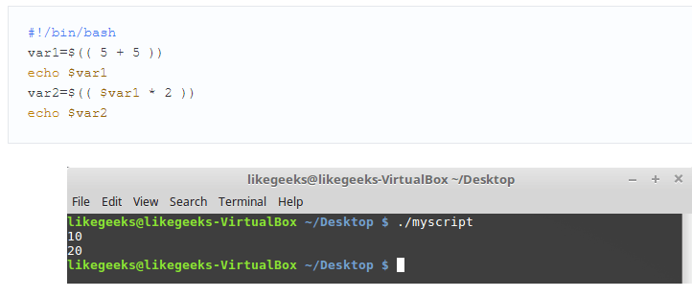
nano ip.sh (IP addressni aniqlash uchun script)
#! /bin/bash
echo “Sizning IP address:”
ifconfig
chmod +x ip.sh (scriptga huquq berish)
./ip.sh (scriptni ishga tushirish)

Slide 8
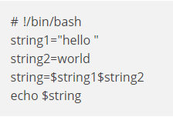
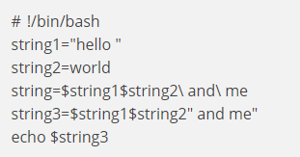
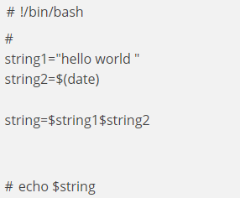
Script yaratish

Slide 9
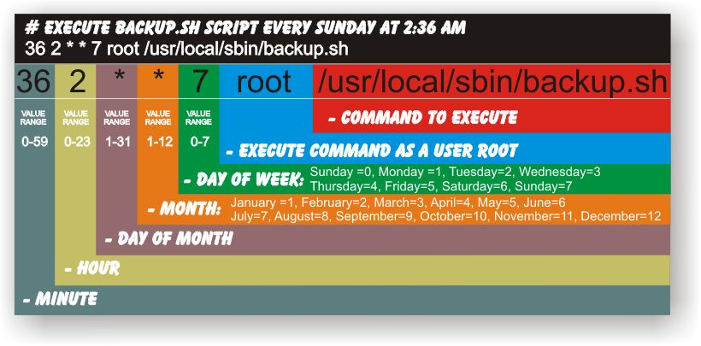
Linux operatsion tizimida Planlar yaratish

Slide 10
Linux operatsion tizimida Planlar yaratish
Cron, ma'lum bir vaqtda vazifalarni (fonda) bajarish uchun ishlatiladigan tizimning xizmatidir.
Crontab komandasi cron xizmatini ishga tushirish uchun buyruqlar va ko'rsatmalar mavjud bo'lgan crontab faylini yaratadi..

Slide 11
Linux operatsion tizimida Planlar yaratish
Har bir crontab usuli quyidagi tartibda berilgan oltita maydondan iborat:
Izoh | Qiymat oralig'i | Ta'rif
minute | 0-59 | ishga tushirish minuti
hour | 0-23 | ishga tushirish soati
day | 1-31 | ishga tushirish kuni
month | 1-12 | ishga tushirish oyi
weekday | 0 - 6 | ishga tushirish kuni(haftadagi)
command |  | Amalga oshirish buyruqlar ketma-ketligi. Ular buyruqlar, bajariladigan fayllar (masalan, skriptlar) yoki fayllarning kombinatsiyasi bo'lishi mumkin.

